Slide 1

Cyclistic Bike Share: Members and Casual Riders
Enhancing marketing strategies to target casual riders

Slide 2
Business Questions: Problem Solving
What is the problem we are trying to solve?
Answer: Figuring out marketing strategies to target those that are not annual members, to become annual members.
How can your insights drive business decisions?
Answer: Figuring out how the casual riders vs. the annual members differ in their use of the bike share company.

Slide 3
Goal Questions
1. How do annual members and casual riders use Cyclistic bikes differently?
2. Why would casual riders buy Cyclistic annual memberships?
3. How can Cyclistic use digital media to influence casual riders to become members?

Slide 4
Theory
I believe that the casual riders are mostly recreational, one timers, or a quick A to B and can be challenging, but not impossible, to convert them to members.

Slide 5
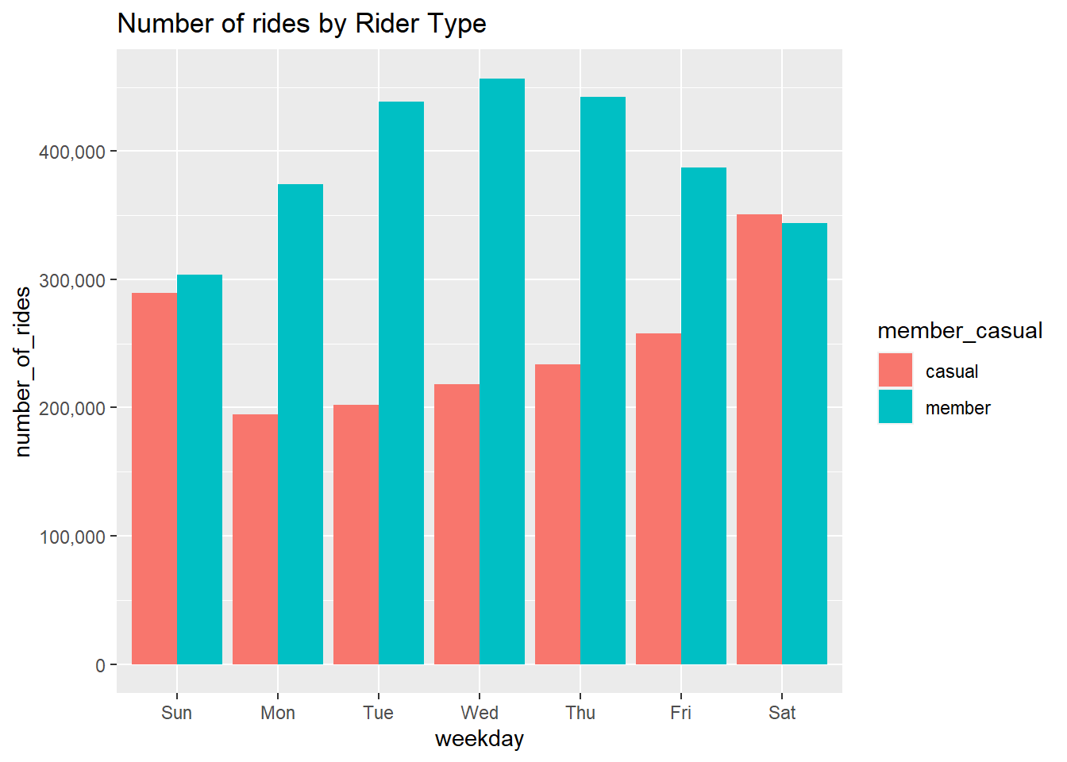
Members Vs. Casual Customers
There are still a lot of casual customers that we need to focus on to convert to members.
Casual customers spike on the weekends.
Members spike during the week.

Slide 6
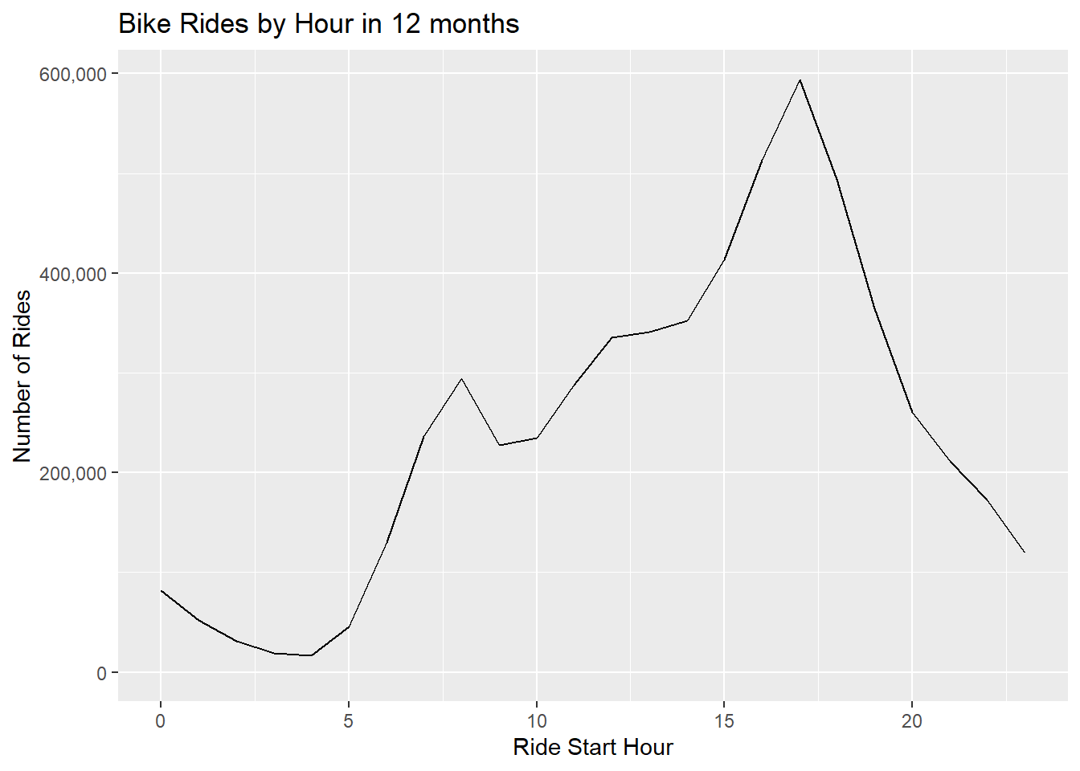
Most Popular Hour
The bike rides spike at around 5pm which would suggest commute use.

Slide 7
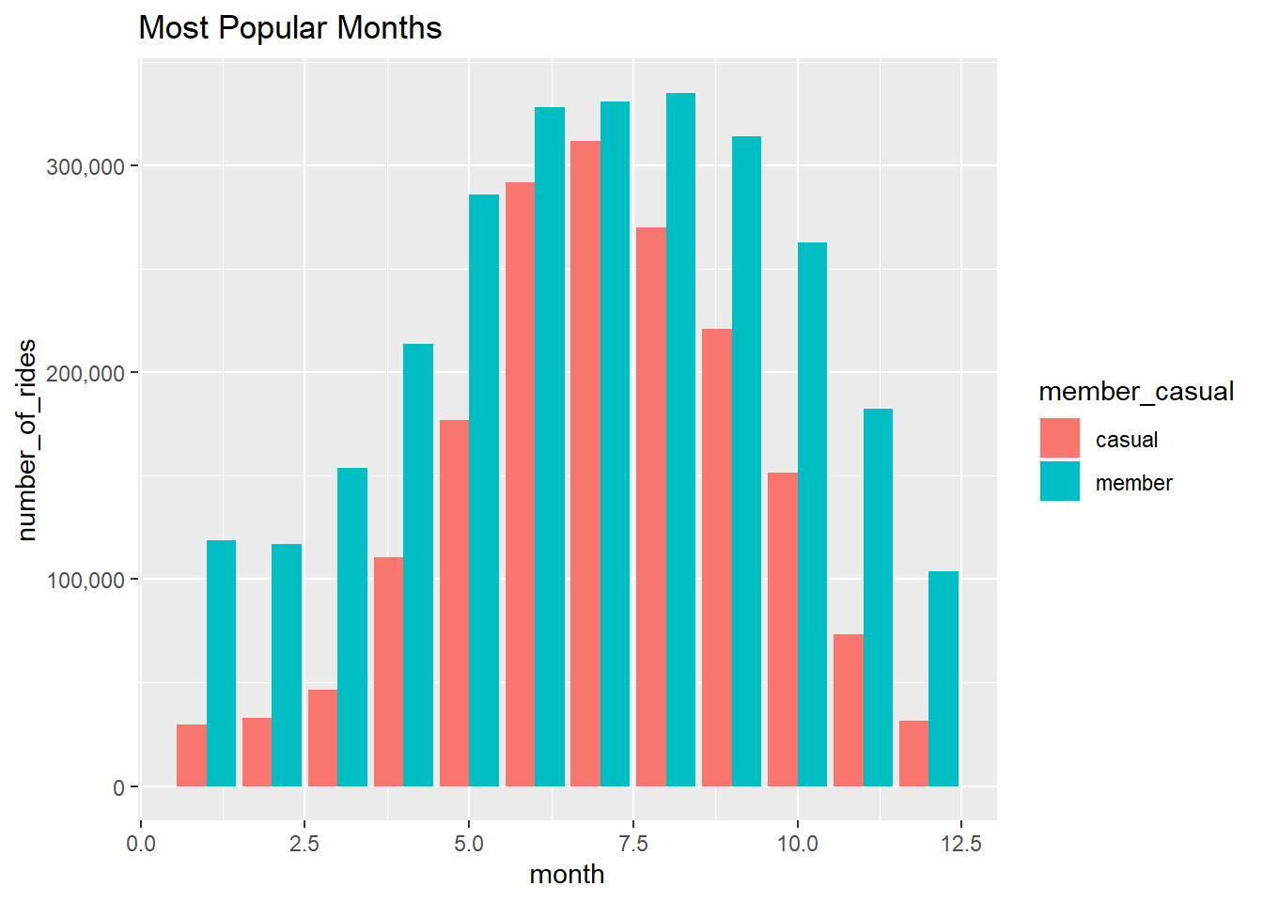
Season Use
Bike use is most popular during the summer months. This could be due to weather and due to more recreational use, ie.: tourists, one time rides.

Slide 8
Findings
Members seem to ride more during the week (Monday-Friday), this may suggest that members mostly use the bikes for commuting to and from work.
Causal riders seem to ride more on Saturday and Sunday which would suggest the causal riders are using the bikes for recreation.
Looking at the hour in which the bikes are most used, it spikes around 5pm, which would suggest commuting home.
The busiest months are in the summer, which may suggest that casual members use the bikes for recreation or one time instances.

Slide 9
Recommendations
It would seem the data supports my hypothesis that casual members are more recreational or one-time riders:
Given this, we can see about different membership types, maybe just a seasonal membership on top of the already in place membership year round.
We can target the one-time riders via social media or have an affiliate program that the influencers can promote to show getting a membership is worth it.
Another suggestion is to have real-life stories of those that are members in more unusual circumstances so that more casual members can justify getting a membership, too.

